Slide 1

Python Introduction
David_Zhu
2022/4/29

Slide 2
Directory
Python install for Windows
Visual Studio Code / Anaconda Spyder
Package Install (Pip install)
Python
Common
Data Type
Data Structure (Tuple(),List[], Set{}, dict{})
Flow control
Module
Exception
Object-oriented programming
Class
Encapsulation
Inheritance
Abstract Class
Polymorphism
Reference

Slide 3
Python Install

Slide 4
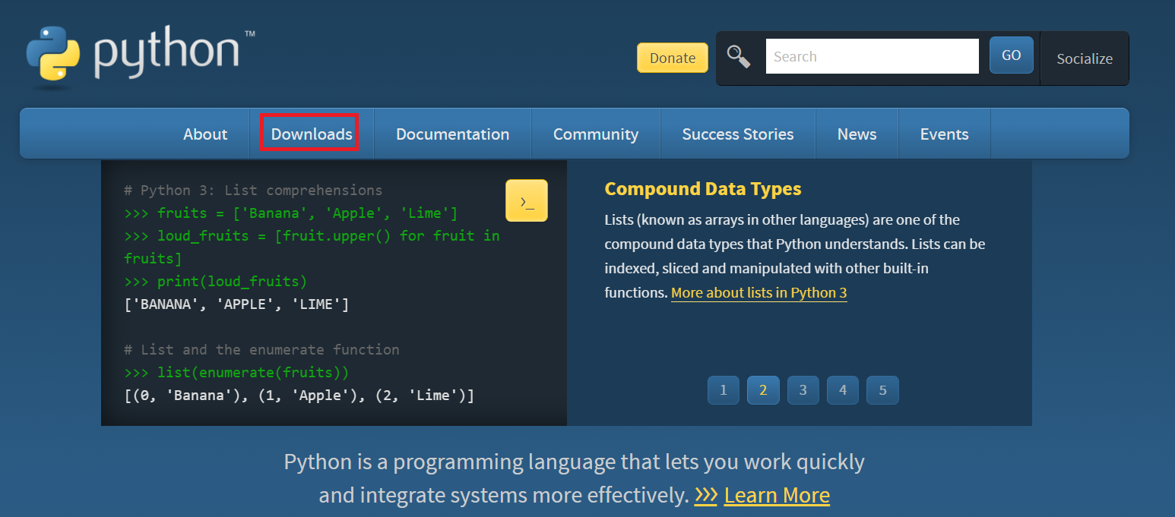
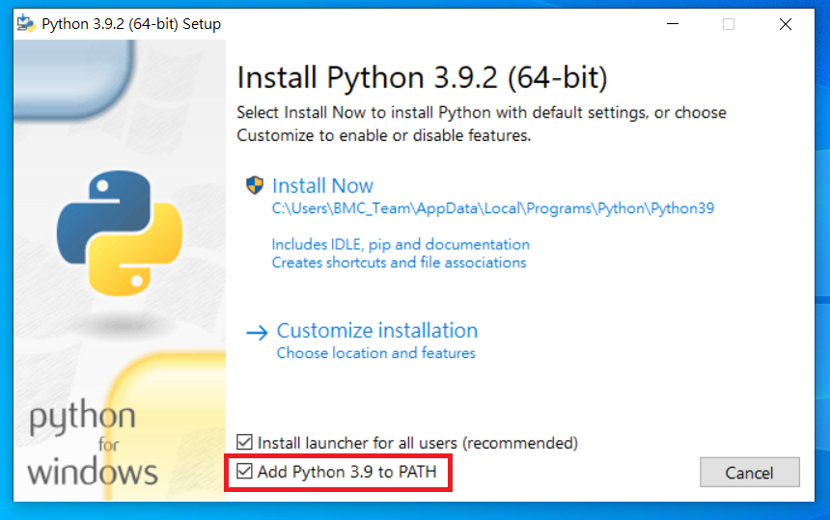
Python Install
Download : https://www.python.org/downloads/

Slide 5
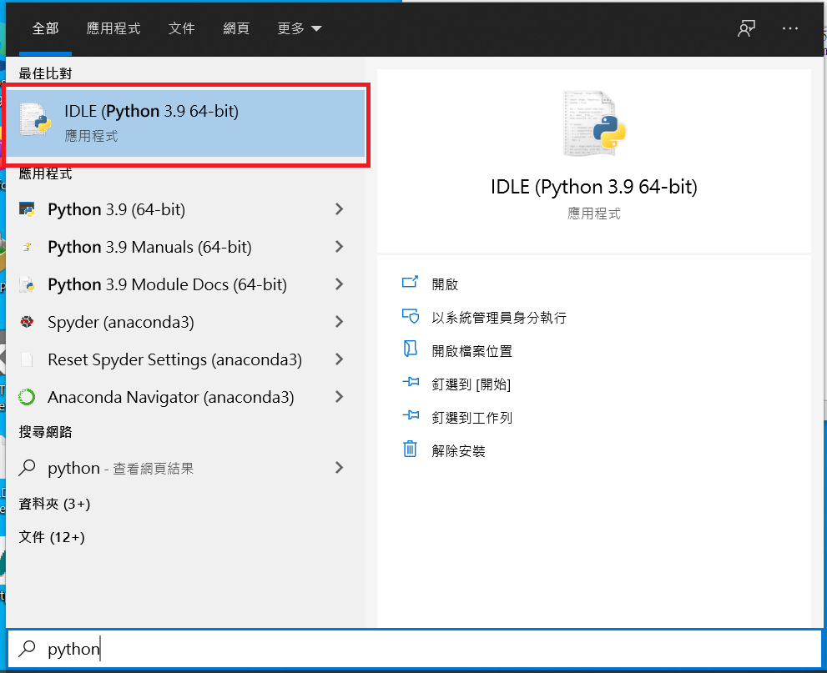
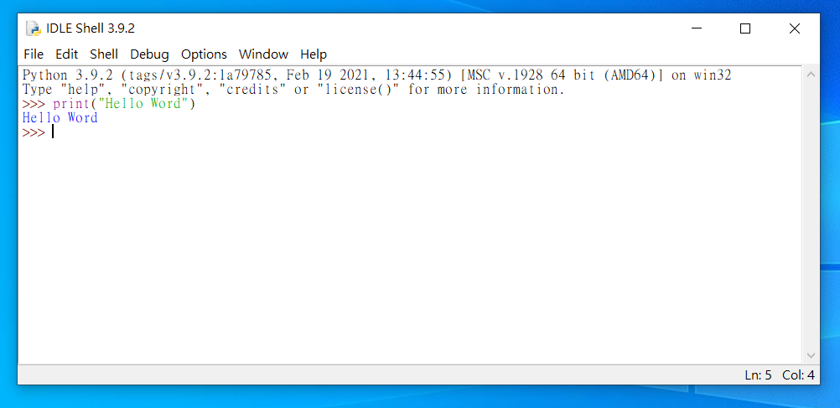
Python Install

Slide 6
Anaconda(Spyder)

Slide 7

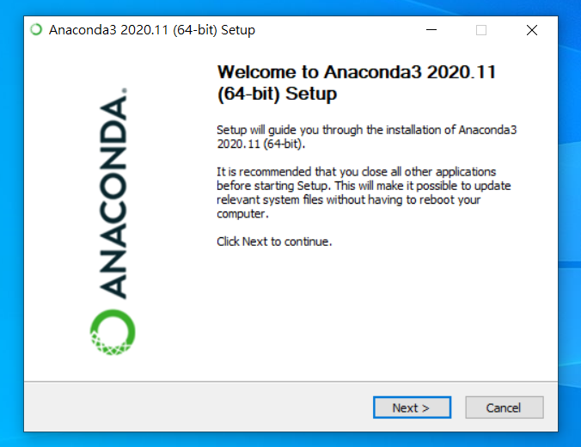
Anaconda (Spyder)
https://www.anaconda.com/products/individual

Slide 8
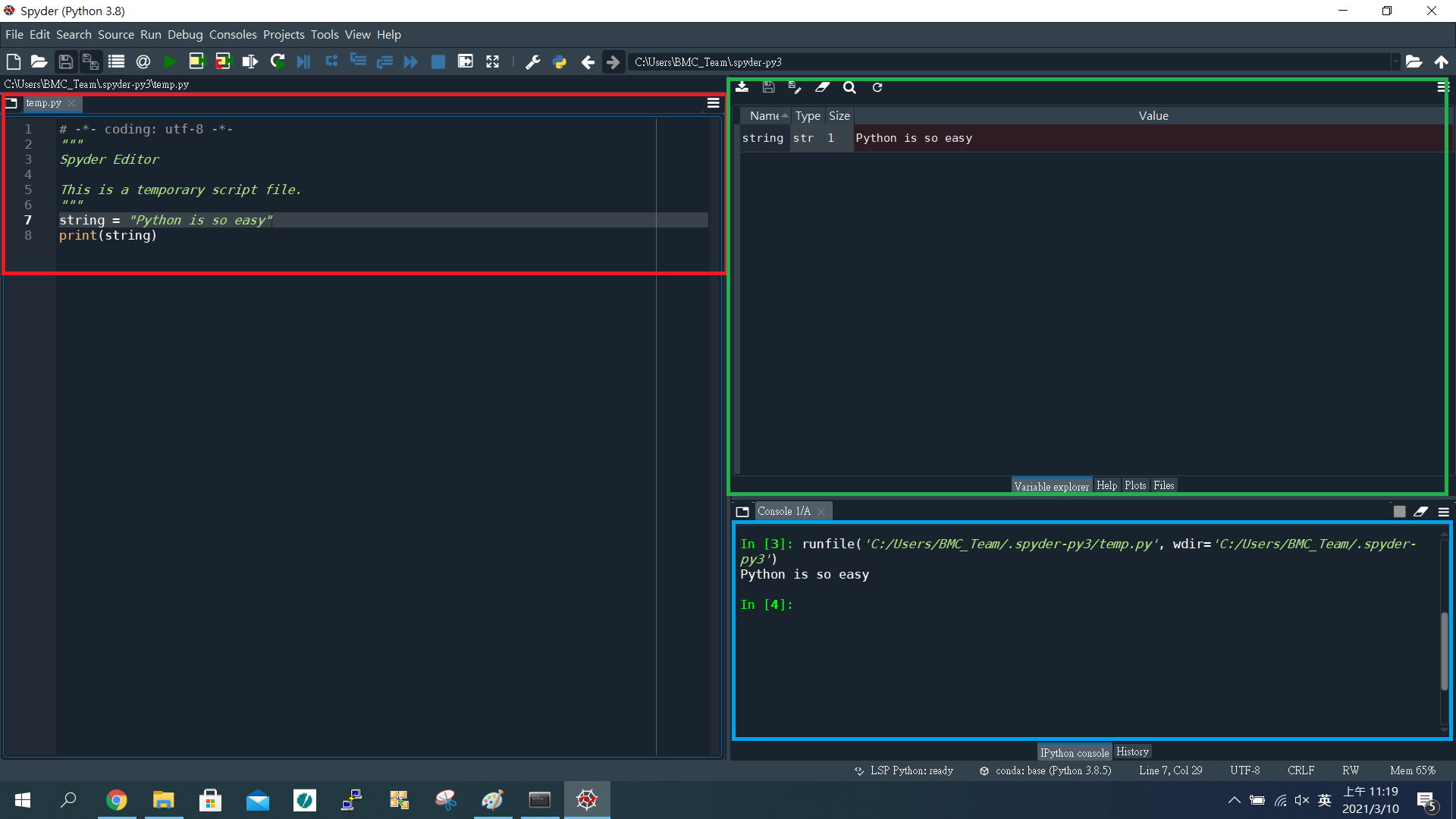
Anaconda (Spyder)
Browse tabs
Variables explorer
Console

Slide 9
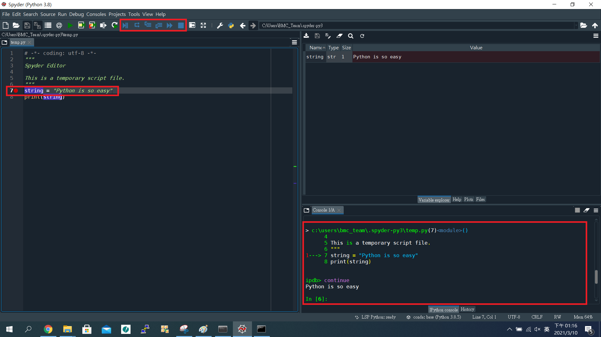
Anaconda (Spyder)
Debug mode
By step to execute
View all of the variables

Slide 10
Visual Studio Code

Slide 11
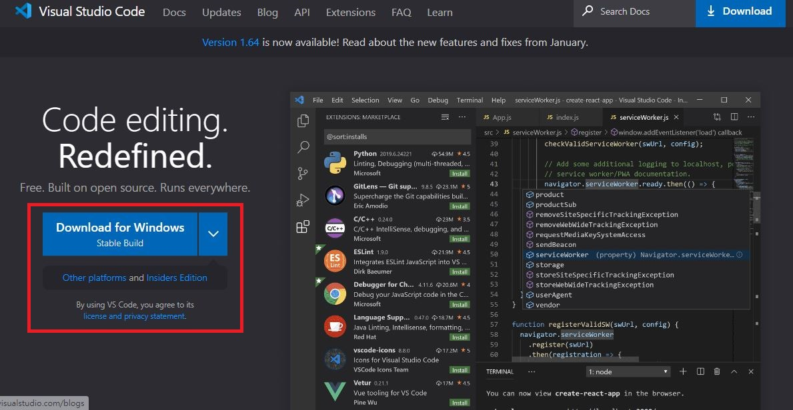
Visual Studio Code
Download : https://code.visualstudio.com/

Slide 12
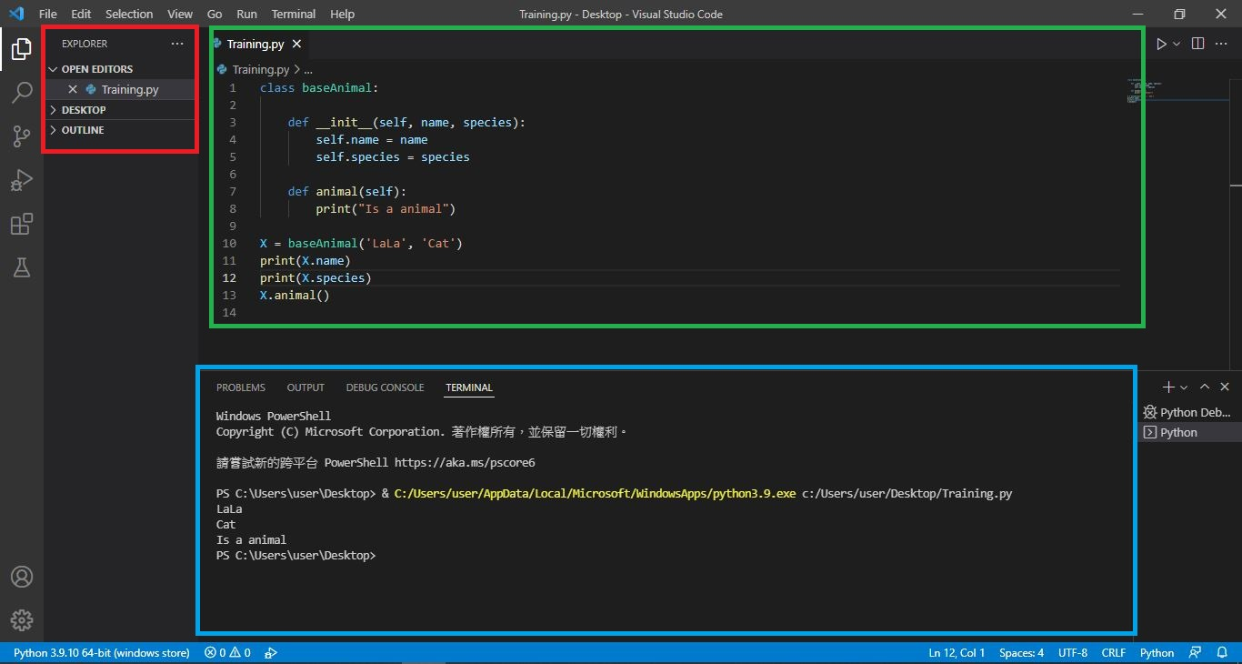
Visual Studio Code
Explorer
Code
Console

Slide 13
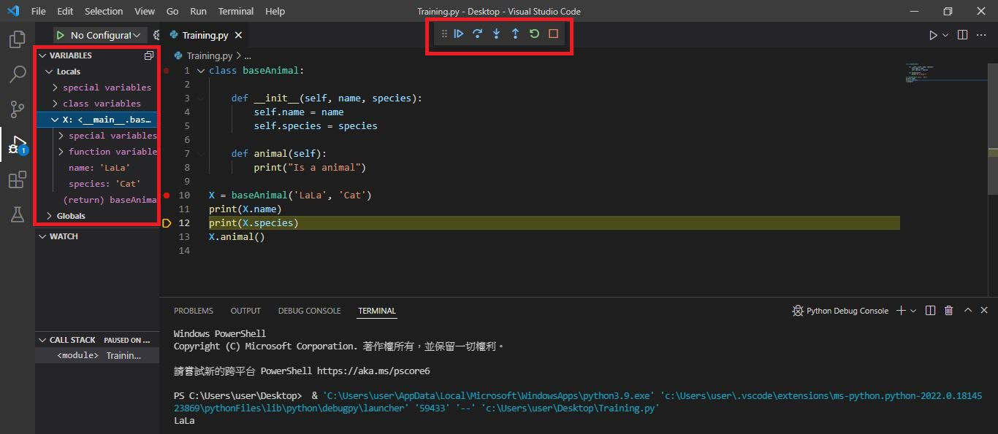
Visual Studio Code
Debug mode
By step to execute
View all of the variables

Slide 14
Package Install

Slide 15
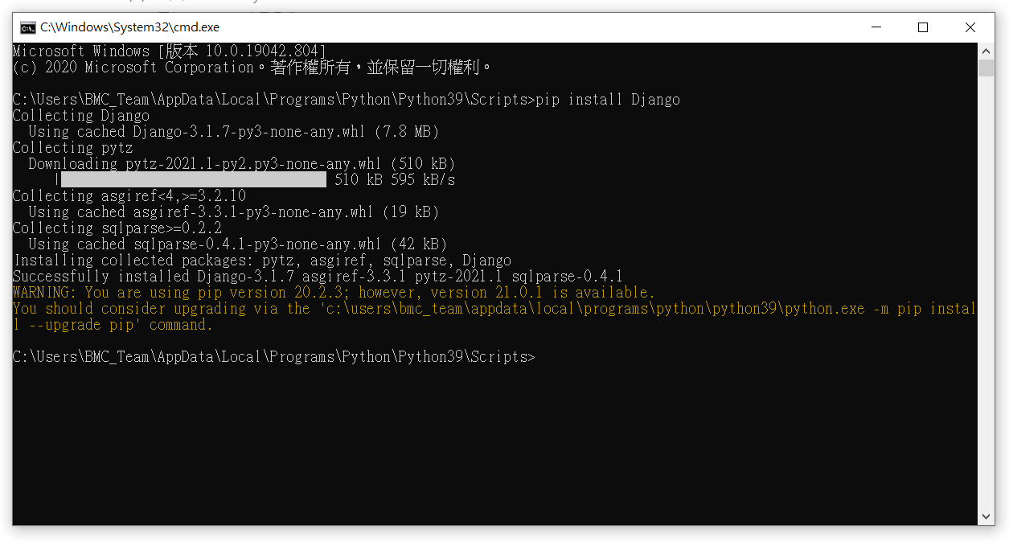
Package Install (Python)
$ pip install $PackageName

Slide 16
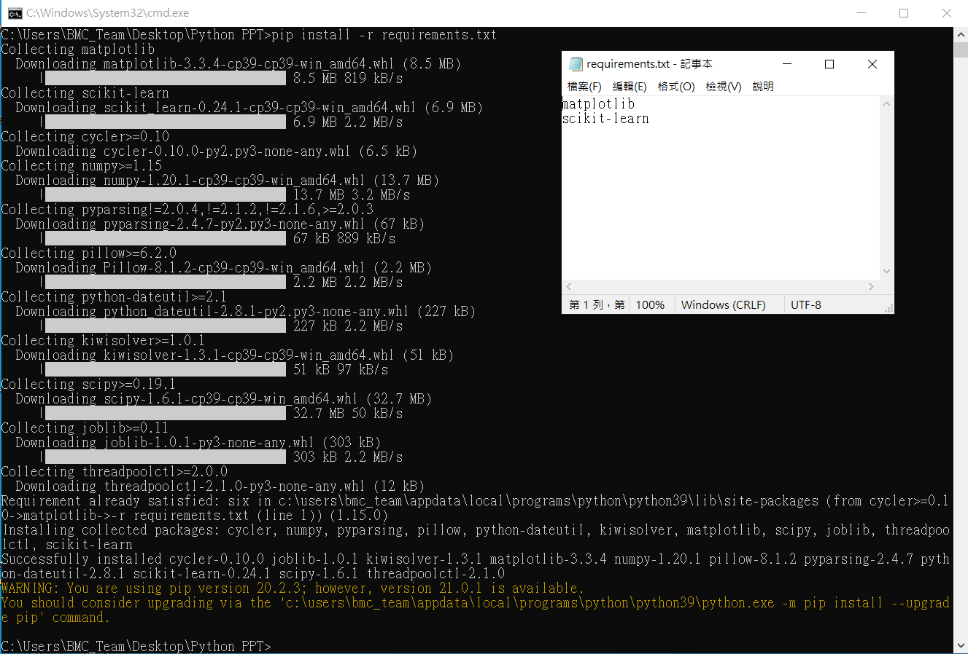
Package Install (requirements.txt)
$ pip install -r requirements.txt

Slide 17
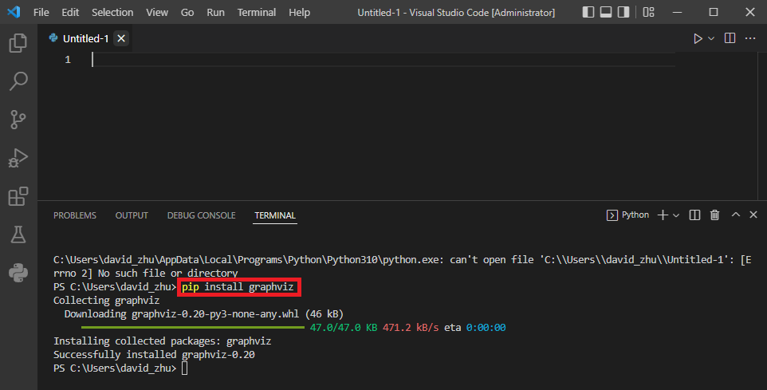
Package Install (VS code)
$ pip install $PackageName

Slide 18
Common

Slide 19
Common(Keyword)
False | class | finally | is | Return
None | continue | for | lambda | Try
True | def | from | nonlocal | While
and | del | global | not | With
as | elif | if | or | Yield
assert | else | import | Pass
break | except | in | Raise
* Don’t used to name the variable

Slide 20
Common(Built-in functions)
abs() | delattr() | hash() | memoryview() | set()
all() | dict() | help() | min() | setattr()
any() | dir() | hex() | next() | slice()
ascii() | divmod() | id() | object() | sorted()
bin() | enumerate() | input() | oct() | staticmethod()
bool() | eval() | int() | open() | str()
breakpoint() | exec() | isinstance() | ord() | sum()
bytearray() | filter() | issubclass() | pow() | super()
bytes() | float() | iter() | print() | tuple()
callable() | format() | len() | property() | type()
chr() | frozenset() | list() | range() | vars()
classmethod() | getattr() | locals() | repr() | zip()
compile() | globals() | map() | reversed() | __import__()
complex() | hasattr() | max() | round()
* Don’t used to name the function

Slide 21
Common(Variable name)
1. First word should be English or _.
2. After the first word that can used English, numeric or _ .

Slide 22
Common(Arithmetic operator)
+ | 加 | a+b
- | 減 | a-b
* | 乘 | a*b
/ | 除 | a/b
% | 取餘數 | a%b

Slide 23
Common(Comparison operator)
< | 小於 | a < b
> | 大於 | a > b
<= | 小於等於 | a <= b
>= | 大於等於 | a >= b
== | 相等 | a == b
!= | 不相等 | a != b
* It will return the Boolean type

Slide 24
Data Type

Slide 25
Data Type
Numeric type
Integer (int)
Floating-point (float)
Boolean (bool)
Text type
String (str)
Sequence type
List
Tuple
4. Set type
set
Mapping type
dict

Slide 26
Data Type (Integer)
x = 1 # Assign 1 to x print(x) # print x print(type(x)) # print x type

Slide 27
Data Type (Float)
x = 1.5 # Assign 1.5 to x print(x) # print x print(type(x)) # print x type

Slide 28

Data Type (Str)
x = “string” # Assign “string” to x print(x) # print x print(type(x)) # print x type

Slide 29
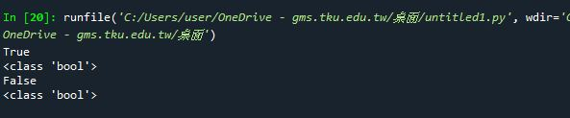
Data Type (bool)
x = True # Assign “True” to bool x
y = False # Assign “False” to bool y
print(x) # print x print(type(x)) # print x type
print(y) # print x print(type(y)) # print x type

Slide 30
Data Structure

Slide 31

Data Structure (Tuple)
y = False #Assign “False” to bool y
x = ( 1 ,“string”, y) #Assign (1, “string”, y) to tuple x
print(x) #print x
print(type(x)) #print x type

Slide 32
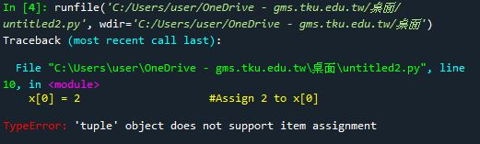
Data Structure (Tuple)
y = False #Assign “False” to bool y
x = ( 1 ,“string”, y) #Assign (1, “string”, y) to tuple x
x[0] = 2 #Assign 2 to x[0]
print(x) #print x
print(type(x)) #print x type
* Tuple object doesn’t support item assignment

Slide 33

Data Structure (List)
y = False #Assign “False” to bool y
x = [ 1 ,“string”, y] #Assign [1, “string”, y] to list x
print(x) #print x
print(type(x)) #print x type

Slide 34

Data Structure (List)
y = False #Assign “False” to bool y
x = [ 1 ,“string”, y] #Assign (1, “string”, y) to tuple x
x[0] = 2 #Assign 2 to x[0]
print(x) #print x
print(type(x)) #print x type
* List object support item assignment

Slide 35

Data Structure (list.append)
y = False #Assign “False” to bool y
x = [ 1 ,"string", y] #Assign [1, “string”, y] to list x
print(x) #print x
print(type(x)) #print x type
x.append("Python") #add “python” to list x
print(x) #print x

Slide 36

Data Structure (list.insert)
y = False #Assign “False” to bool y
x = [ 1 ,"string", y] #Assign [1, “string”, y] to list x
print(x) #print x
print(type(x)) #print x type
x.insert(0,"python") #insert “python” to list x[0]
print(x) #print x

Slide 37

Data Structure (list.remove)
y = False #Assign “False” to bool y
x = [ 1 ,"string", y] #Assign [1, “string”, y] to list x
print(x) #print x
print(type(x)) #print x type
x.remove(y) #remove y from list x
print(x) #print x

Slide 38

Data Structure (Two-dimensional List)
list1 = [[1,2,3], # Assign 1~9 to two-dimensional list
[4,5,6],
[7,8,9]]
print(list1[1][0]) # Print list[1][0]
print(list1[1][1]) # Print list[1][1]

Slide 39
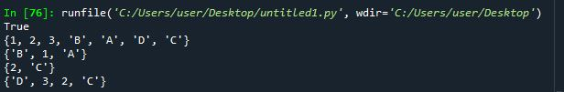
Data Structure (Set)
set1 = {"A","B","C",1 ,2}
set2 = {"A","B","D",1 ,3}
print(“A” in set1) # “A” in set1 or not
print(set1 | set2) # Union (聯集)
print(set1 & set2) # Intersection (交集)
print(set1 - set2) # Subtraction (差集)
print(set1 ^ set2) # XOR (互斥或)

Slide 40

Data Structure (Dict)
dict = {"Name" : "David", "Age" : 28, "Weight" : 70, "Height" : 176}
print(dict["Name"])
print(dict["Age"])
print(dict["Weight"])
print(dict["Height"])

Slide 41
Flow control

Slide 42
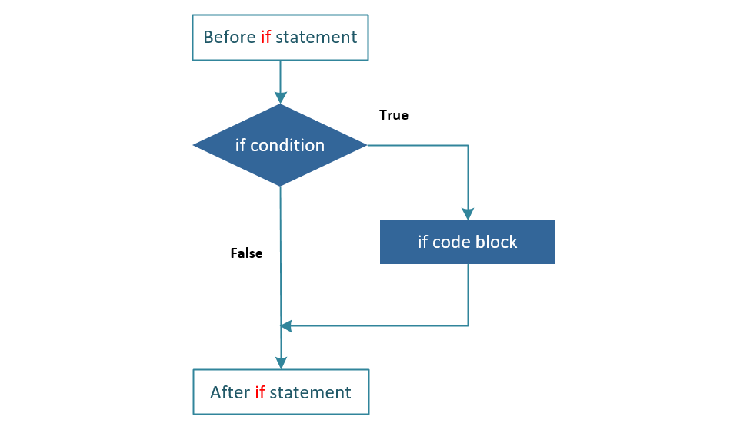
Flow control (If_else)

Slide 43

Flow control (If_else)
x = int(input("Please enter an integer: ")) # Assign input number to x
if x < 50:
print("The Integer is small than 50") # If x < 50, print
elif x > 50:
print("The Integer is more than 50") # If x > 50, print
else:
print("The Integer is 50") # If not meets above, print

Slide 44
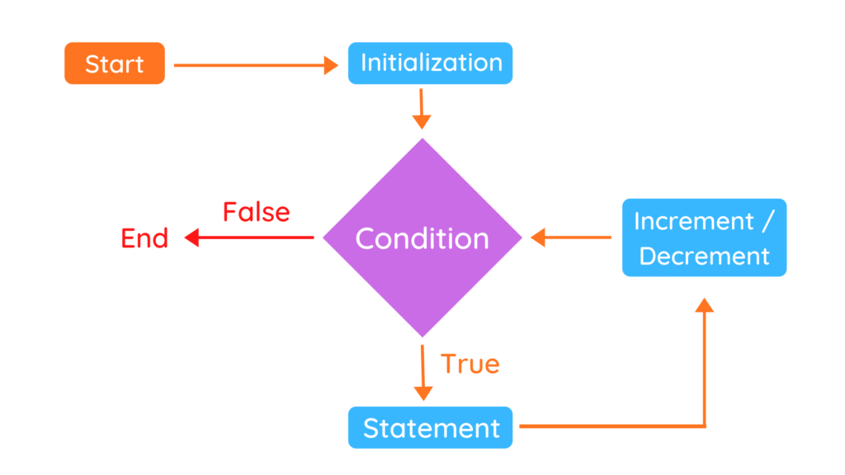
Flow control (for_loop)

Slide 45

Flow control (for_loop)
words = ["Python", "Java", "C++"] # Assign List[] to words
for w in words:
print(w, len(w)) # Print w in words[] and count it.

Slide 46
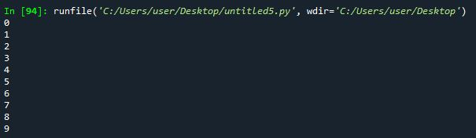
Flow control (for_range)
for i in range(10):
print(i) # Print i from 0 to 9

Slide 47
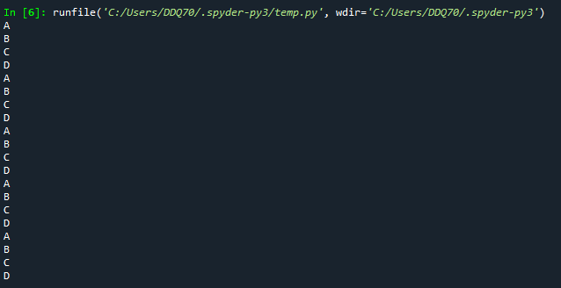
Flow control (nested_loops)
words = [“A”, “B”, “C”, “D”] #Assign “A”, “B”, “C”, “D” to words
for i in range(5):
for j in words:
print(j) #Print j

Slide 48
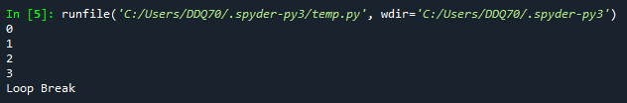
Flow control (break)
for i in range(5):
print(i) #Print i
if i == 3:
print(“Loop Break”) #if i = 3, print “Loop Break” then break loop
break

Slide 49

Flow control (continue)
for i in range(5):
if i == 3: #if i = 3
continue #Bypass then continue loop
print(i) #Print i

Slide 50
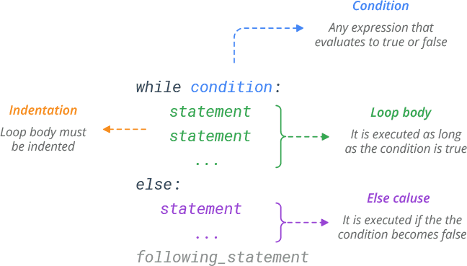
Flow control (while_loop)

Slide 51
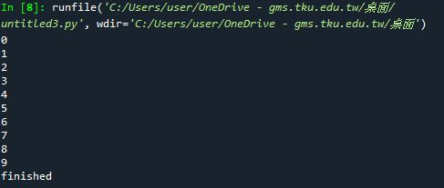
Flow control (while_loop)
i = 0 # assign 0 to i
while i < 10: # if i < 10 is true
print(i) # print i
i += 1 # I + 1
else:
print(“finished”) # if i < 10 is false

Slide 52
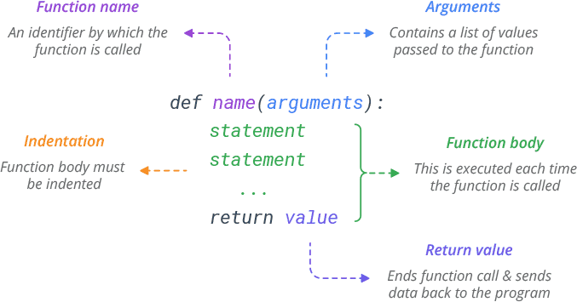
Flow control (function)

Slide 53
Flow control (function)
def example(n): # function example()
n+=5 # n = n + 5
print(n) # print n
example(10) # call function example()

Slide 54
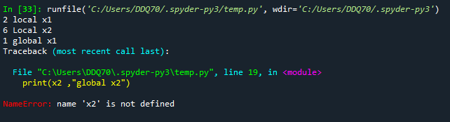
Flow control (global/local variable)
x1 = 1 # Assign 1 to x1
def example(): # Function example()
x1 = 2 # Assign 2 to x1
x2 = 6 # Assign 6 to x2
print(x1,“local x1”) # print local x1
print(x2,”local x2”) # print local x2
example() # call function example()
print(x1, ”global x1”) # print global x1
print(x2, “global x2”) # print global x2

Slide 55
Module

Slide 56
Module
#temp.py
def example1():
print(“example1 function”)
def example2():
print(“example2 function”)
#import.py
import temp
temp.example1()
temp.example2()

Slide 57
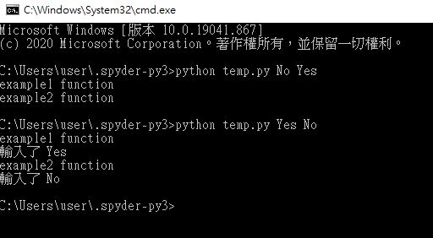
Module (Used by CMD)
#temp.py
import sys
def example1(n):
print("example1 function")
if n == "Yes":
print("輸入了 Yes")
def example2(m):
print("example2 function")
if m == "No" :
print("輸入了 No")
if __name__ == "__main__":
example1(str(sys.argv[1]))
example2(str(sys.argv[2]))

Slide 58
Exception

Slide 59
Exception (Error Type)
# Exception (checking)
# EX : ValueError, NameError, TypeError
# Runtime Exception (unchecking)
# EX : OS crash, HW component error …….
# Can’t be catch by python.

Slide 60
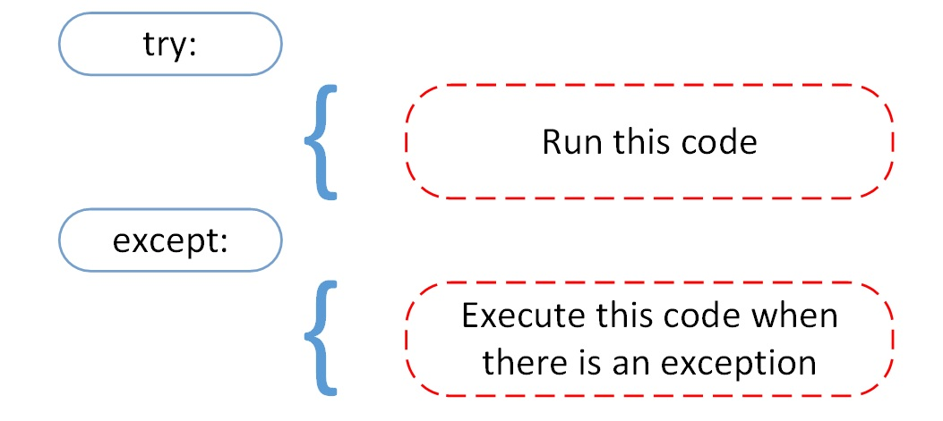
Exception (Error Type)

Slide 61
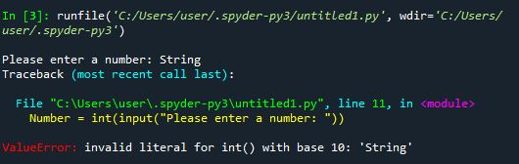
Exception (Error)
# Exception error
Number = int(input( "Please enter a number : "))

Slide 62
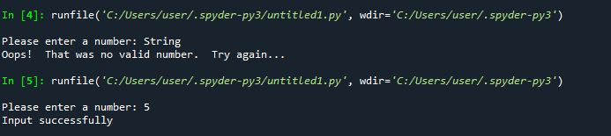
Exception (try_catch)
# Exception error
try:
Number = int(input("Please enter a number: "))
except ValueError:
print("Oops! That was no valid number. Try again...")
else:
print("Input successfully")

Slide 63
Object-oriented Programming

Slide 64
Object-oriented Programming
Encapsulation 封裝 : 一種將函式介面的實作細節部份包裝、隱藏起來的方法，它也是一種防止外界呼叫端，去存取物件內部實作細節的手段。
Inheritance 繼承 : 繼承可以使得子類具有父類別別的各種屬性和方法，而不需要再次編寫相同的代碼。
Polymorphism 多型 : 指為不同資料類型的實體提供統一的介面。

Slide 65
Class (類別)
# Class sample
class baseClassName:
<statement-1>
.
.
.
<statement-N>

Slide 66

Class (類別)
# Animal Class
class baseAnimal: # baseAnimal class
y = "Is not a animal“
def animal(self):
print("Is a animal")
X = baseAnimal() # Implement
print(X.y) # Call y
X.animal() # Call animal method

Slide 67

Class ( __init__ 建構子)
# Animal Class
class baseAnimal:
def __init__(self, name, species):
self.name = name
self.species = species
def animal(self):
print("Is a animal")
X = baseAnimal('LaLa', 'Cat')
print(X.name)
print(X.species)
X.animal()
#__init__ 作為設定物件初始化資料使用

Slide 68
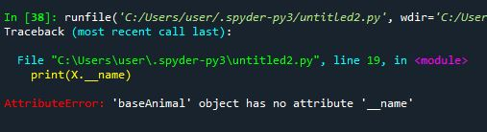
Encapsulation (封裝)
# Animal Class
class baseAnimal: #透過封裝防止內部資料直接被外部呼叫
def __init__(self, name, species):
self.__name = name
self.__species = species
def animal(self):
print("Is a animal")
X = baseAnimal('LaLa', 'Cat')
print(X.__name)
print(X.__species)
X.animal()

Slide 69

Encapsulation (封裝)
# Animal Class
class baseAnimal:
def __init__(self, name, species):
self.__name = name
self.__species = species
def getAnimalName(getname):
return getname.__name
def getAnimalSpecies(getspecies):
return getspecies.__species
X = cat("LaLa","Cat")
print(X.getAnimalName())
print(X.getAnimalSpecies())
#透過 Method 回傳被封裝的資料

Slide 70
Inheritance (繼承)
# Inheritance
class DerivedClassName(BaseClassName):
<statement-1>
.
.
.
<statement-N>

Slide 71

Inheritance (繼承)
# Animal Class
class baseAnimal:
def __init__(self, name, species):
self.__name = name
self.__species = species
def getAnimalName(getname):
return getname.__name
def getAnimalSpecies(getspecies):
return getspecies.__species
class cat(baseAnimal):
def update(self):
return "喵喵叫"
X = cat("LaLa","Cat")
print(X.getAnimalName()) #透過繼承取得父類別 Method
print(X.getAnimalSpecies())
print(X.update())

Slide 72
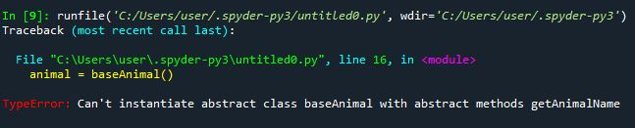
Abstract Class (抽象類別)
# Abstract Class
from abc import ABC, abstractmethod
class baseAnimal(ABC):
@abstractmethod
def getAnimalName(getname):
pass
@abstractmethod
def getAnimalSpecies(getspecies):
pass
animal = baseAnimal() #抽象類別無法被直接實例化

Slide 73

Abstract Class (抽象類別)
# Abstract Class
from abc import ABC, abstractmethod
class baseAnimal(ABC):
@abstractmethod
def getAnimalName(getname):
pass
@abstractmethod
def getAnimalSpecies(getspecies):
pass
class cat(baseAnimal): #抽象類別需透過繼承來實現
def __init__(self,name,species):
self.name = name
self.species = species
def getAnimalName(self):
print(self.name)
def getAnimalSpecies(self):
print(self.species)
cat1 = cat("Lala","橘貓")
cat1.getAnimalName()
cat1.getAnimalSpecies()

Slide 74
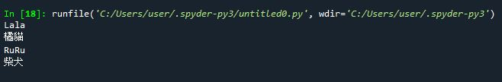
Polymorphism (多型)
# Abstract Class
from abc import ABC, abstractmethod
class baseAnimal(ABC):
@abstractmethod
def getAnimalName(getname):
pass
@abstractmethod
def getAnimalSpecies(getspecies):
pass
class cat(baseAnimal):
def __init__(self,name,species):
self.name = name
self.species = species
def getAnimalName(self):
print(self.name)
def getAnimalSpecies(self):
print(self.species)
class dog(baseAnimal):
def __init__(self,name,species):
self.name = name
self.species = species
def getAnimalName(self):
print(self.name)
def getAnimalSpecies(self):
print(self.species)
cat1 = cat("Lala","橘貓")
dog1 = dog("RuRu", "柴犬")
cat1.getAnimalName() #透過不同的實例化物件來呼叫 Method
cat1.getAnimalSpecies()
dog1.getAnimalName() #透過不同的實例化物件來呼叫 Method
dog1.getAnimalSpecies()

Slide 75
Reference
Python download
https://www.python.org/downloads/
Anaconda download
https://www.anaconda.com/products/individual
Python Document
https://docs.python.org/zh-tw/3/tutorial/index.html
Python Learn by example
https://www.learnbyexample.org/python-introduction/

Slide 76
Q&A

